Slide 1
Cost Analysis
Professor Ravi Kiran

Slide 2
Cost and Price
The words cost and price are often confused.
When we discuss costs we mean, how much did something cost to produce. This might be expressed in a currency such as rupees.
When price is mentioned, it is means, the amount the consumer pays.
Why does one thing cost more to produce than another?
Why does making an airplane cost so much less in a big factory than in a small factory.

Slide 3
Explicit Cost and Implicit Cost
Explicit Cost : cost paid to the hired Factors of Production
Implicit Cost : cost paid to Self used and self employed factors of Production

Slide 4
Costs
A firm draws Rs 1,00,000 from the bank out of its savings in order to invest in new plant and equipment.
The opportunity cost of this investment is not just the Rs100 000 (an explicit cost), but also the interest forgone (an implicit cost).
The owner of the firm could have earned Rs 20,000 per annum by working for someone else. This Rs 20000 then is the opportunity cost of the owner’s time.

Slide 5
Costs
If there is no alternative use for a factor of production, as in the case of a machine designed to produce a specific product, and if it has no scrap value, the opportunity cost of using it is zero.
In such a case, if the output from the machine is worth more than the cost of all the other inputs involved, the firm might as well use the machine rather than let it stand idle.
What the firm paid for the machine – its historic cost – is irrelevant. Not using the machine will not bring that money back. It has been spent. These are sometimes referred to as ‘sunk costs’.

Slide 6
THE FALLACY OF USING HISTORIC COSTS
If you fall over and break your leg, there is little point in saying, ‘If only I hadn’t done that I could have gone on that skiing holiday; I could have taken part in that race;
I could have done so many other things. Wishing things were different won’t change history.
You have to manage as well as you can with your broken leg.
It is the same for a firm. Once it has purchased some inputs, it is no good then wishing it hadn’t. It has to accept that it has now got them, and make the best decisions about what to do with them.

Slide 7
THE FALLACY OF USING HISTORIC COSTS
Take a simple example. The local greengrocer in early December decides to buy 100 Christmas trees for £ 10 each.
At the time of purchase, this represents an opportunity cost of £10 each, since the £10 could have been spent on something else.
The greengrocer estimates that there is enough local demand to sell all 100 trees at £20 each, thereby making a reasonable profit.

Slide 8
THE FALLACY OF USING HISTORIC COSTS
But the estimate turns out to be wrong.
On 23 December there are still 50 trees unsold.
What should be done?
At this stage the £10 that was paid for the trees is irrelevant. It is a historic cost. It cannot be recouped: the trees cannot be sold back to the wholesaler!
In fact, the opportunity cost is now zero. It might even be negative if the greengrocer has to pay to dispose of any unsold trees. It might, therefore, be worth selling the trees at £10, £5 or even £1.
Last thing on Christmas Eve it might even be worth giving away any unsold trees.

Slide 9
Fixed cost
If aircraft are to be made then a factory is required.
The land, the factory building, the machinery and office equipment must be bought or rented.
These costs are called fixed costs and must be paid even when the factory has not produced anything.
Fixed costs are costs that do not change, whatever the level of output is.

Slide 10
Y
TFC
TFC
60
O
X
Units of output

Slide 11
Variable costs
Variable costs change as the level of output changes.
These costs are costs such as raw materials in production, labour units, electricity charges etc.
In our example this would be the steel, components and labour needed to make each airplane.
If nothing were made the variable costs would of course be nothing. But as production rises the total variable costs (TVC) would rise.
The variable cost is the cost per unit. The total variable cost is found by multiplying the variable cost (VC) by the level of output (Q)
TVC = VC x Q.

Slide 12
TVC
TVC
The TVC curve is an inverted S upward sloping curve. The main reason for the shape of the TVC curve is the operation of the law of variable proportion. As the total output increases, the TVC initially increases at a decreasing when the production is experiencing increasing returns.
O
TVC

Slide 13
Total costs
Total costs are simply the sum of the total variable costs and the fixed costs. Note that the TC and TVC lines are parallel.
The distance between the two lines is the amount of the fixed costs.

Slide 14
Output | FC | TVC | TC
0 | 60 | 0 | 60
10 | 60 | 10 | 70
20 | 60 | 20 | 80
30 | 60 | 30 | 90
40 | 60 | 40 | 100
50 | 60 | 50 | 110

Slide 15
Total costs
Y
TC
TFC
TVC
60
TFC
X
O
Units of output

Slide 16
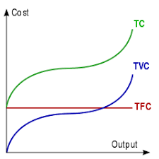
Total Cost
The TC curve is inverted-S shaped. This is because of the TVC curve. Since the TFC curve is horizontal, the difference between the TC and TVC curve is the same at each level of output and equals TFC.

Slide 17
Average Cost
Average costs are per unit costs
Average fixed costs (AFC) are the fixed costs divided by the level of output (FC/Q).
So when output is 10 the AFC is 60/10 = 6.
Average variable costs (AVC) are the total Variable costs divided by the level of output (TC/Q).
Average total costs (ATC) are the total costs divided by the level of output (TC/Q).
So when output is 10 the average fixed cost is 70/10 = 7.

Slide 18
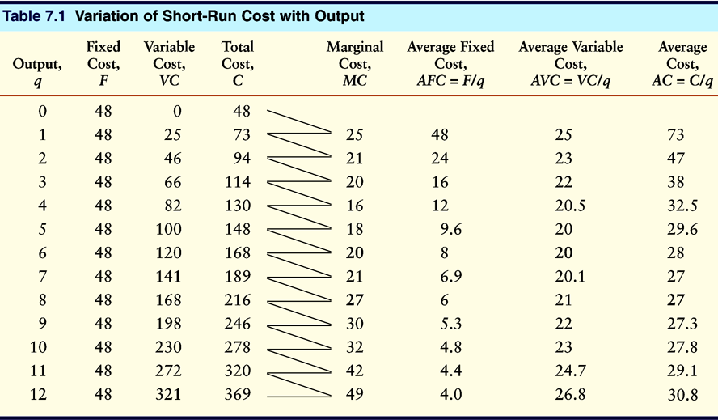

Slide 20
Marginal Cost
Marginal cost
Marginal cost is the cost of producing one extra unit.
Marginal cost = the change in total costs
the change in output
MC = ΔTC
ΔQ

Slide 21
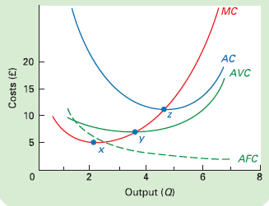
Average and marginal costs

Slide 22
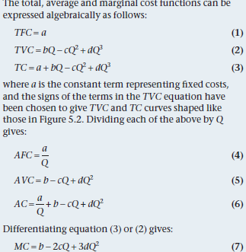

Slide 23
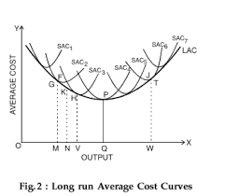
Long Run Average Cost Curve

Slide 24
LAC
The long-run average cost (LAC) curve shows the firm's lowest cost per unit at each level of output, assuming that all factors of production are variable. The LAC curve assumes that the firm has chosen the optimal factor mix, as described in the previous section, for producing any level of output.
It is Disc Shaped Curve.
It is envelop of SACs

Slide 25
Long Run Average cost curve
LAC
SAC3
SAC1
SAC2
0
q
q
q₃
Q
Output per day
1
2

Slide 26
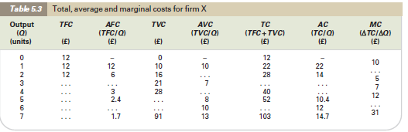
Fill in the missing figures

